Slide 1
AI Driven Risk Analysis
Exploring AI's Impact on Entity Intelligence and Risk Management
Team: ByteBuffer
Aditya Khanna
Priyanshu Bhargav
Purva Patil

Slide 2

Approach for solution
Data Ingestion: Collects unstructured & structured data from multiple sources (World Bank, SEC EDGAR, Sanction Lists).
Entity Extraction: Uses NLP & Named Entity Recognition (NER) to detect companies, transactions, and risks.
Risk Feature Engineering: Extracts financial, legal, and compliance risk indicators.
ML-Based Scoring: Applies AI models to assign a risk score from 0 (low risk) to 100 (high risk).
Visualization & Reporting: Provides insights on risk distribution, trends, and flagged entities

Slide 3
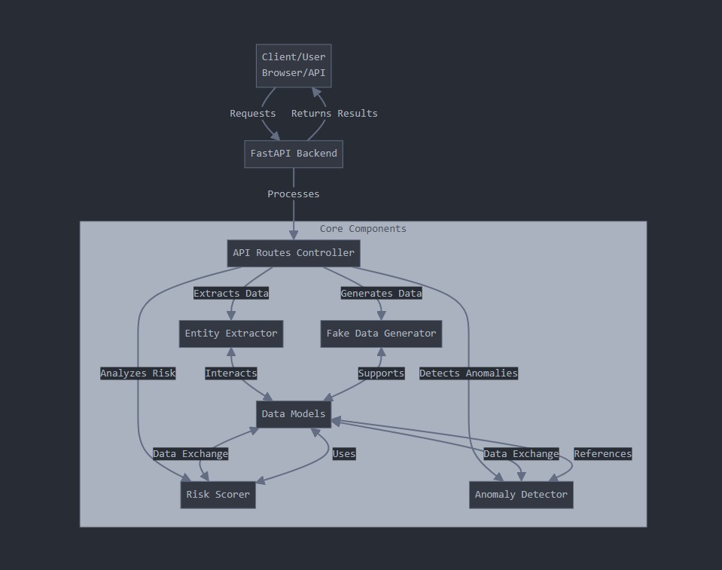
Architecture Diagram

Slide 4
Models used
FastAPI: Web framework
Pydantic: Data validation
spacy: en_core_web_sm for Natural Language Processing

Slide 5
Challenges
Challenge | Solution Implemented
Unstructured financial text (SEC filings, reports) | Used LLMs & NLP to structure the data
No direct transaction database | Fetched indirect indicators from World Bank & SEC filings

Slide 6
Data sources used
"wikipedia": "https://en.wikipedia.org/wiki/",
"sec_edgar": "https://data.sec.gov/submissions/",
"open_corporates_web": "https://opencorporates.com/companies/"
"lei_lookup": https://api.gleif.org/api/v1/lei-records?filter[lei]=
"https://www.treasury.gov/ofac/downloads/sdn.xml",
"https://www.sanctionsmap.eu/api/v1/sanctions"

Slide 7
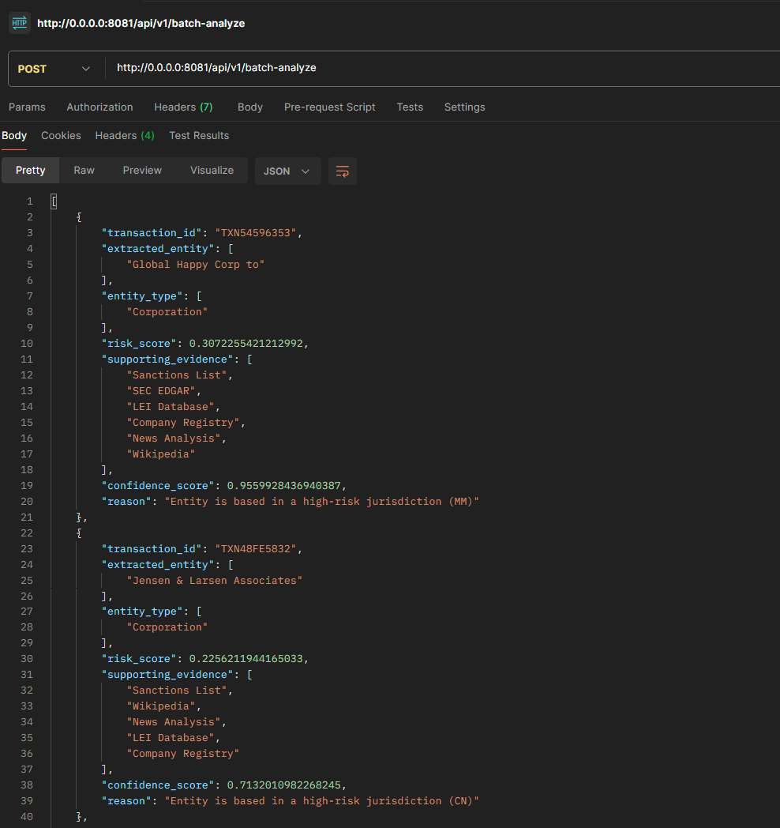
Response of API

Slide 8

Results
# API Endpoints-
GET /api/v1/generate-transaction: Generate a fake transaction
POST /api/v1/analyze: Analyze transaction data
POST /api/v1/batch-analyze: Generate and analyze multiple transactions
GET /api/v1/entity/{entity_id}: Get entity details
GET /api/v1/risk-score/{entity_id}: Get entity risk score
GET /api/v1/extract-entities: Extract entities from text

